Slide 1
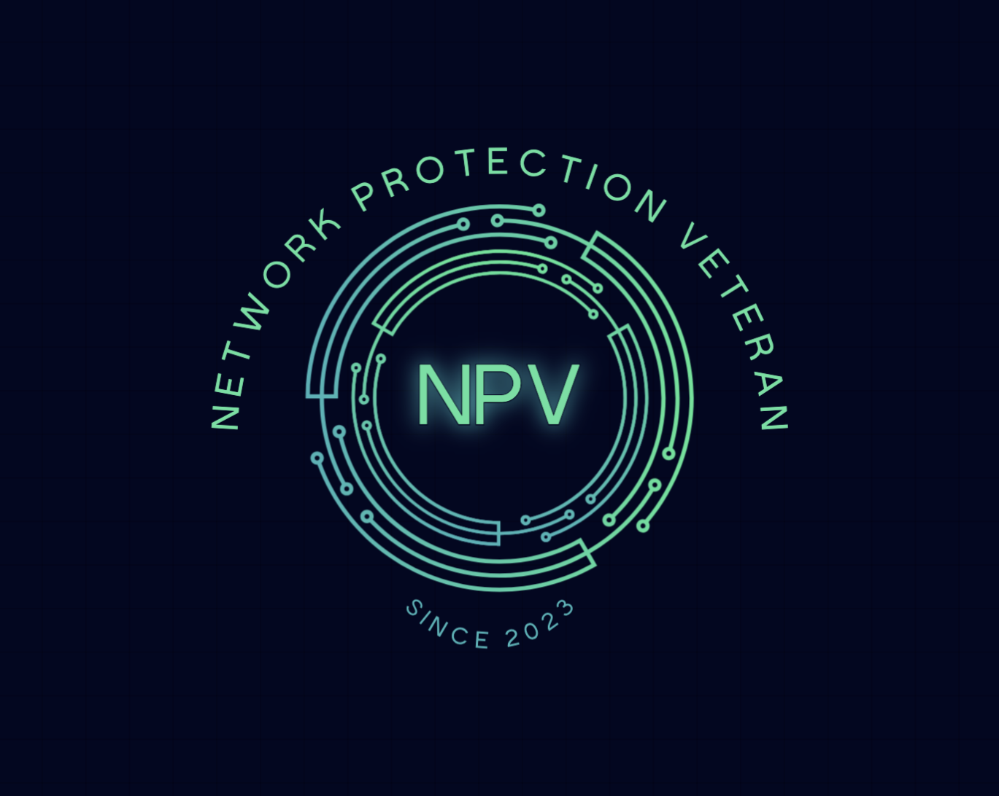

Slide 2

AGENDA
Team Member Introductions
Problem Domain
Live Demo
Q&A
Solution

Slide 3

US Army veteran, giant tech enthusiast, familiar with Windows and Linux, grew up with IT in my life but never made a break into the industry. Self proclaimed cyber security analyst and knower of weird things, reptile​
CODY JUHL

Slide 4

WILLIAM BAUR
12-Year Marine Corps Veteran serving as a system administrator familiar with Windows, Linux, Unix operating systems, networking, and active directory.
Experienced with Windows, Linux, Unix operating systems, networking, and active directory. Bachelor's degree in Finance and additional experience in Healthcare, Banking, Executive recruitment, and Sales

Slide 5
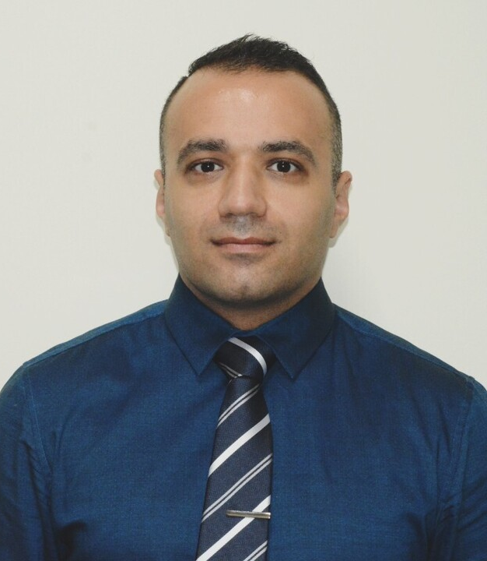
SYED HASHEMI
AN Army Veteran with specialty in CBRN operations.
Solid background in Biology worked in labs for 7 years, and recently quit my job as Maintenance manager to pursue my passion in Cyber Security and Network Administration.

Slide 6

THIERRY TRAN
US Army Veteran
Just separated last month
B.S in Computer Science
My brother-in-law inspired me for Cybersecurity field

Slide 7
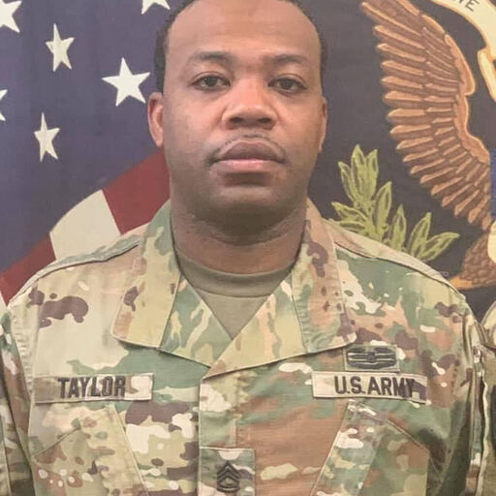
Tommy S Taylor II
Army Veteran of 20 years.
BA in Information
Systems Security.
Currently have the ITIL
Foundations Certification and recently graduated the Cyber Security Analyst Certification course through IBM Skills Build.

Slide 8

Brittany Powell
A veteran.
A military police in the Alabama National Guard for 9 years.
A civilian police officer for 7 years.
During my time on the force I've done public relations, a member of the Special Response Team, and an instructor.

Slide 9

Problem Domain
Client Overview:
InnovateTech, a rapidly growing tech firm.
Workforce of 20 employees across Sales, R&D, and IT Management.
Emphasis on a robust and secure network infrastructure.
Project Objectives:
Comprehensive network upgrade led by NPV Tech Solutions.
CEO's emphasis on seamless communication, data security, and collaboration.
Implementation of reliable backup solutions and streamlined IT onboarding.
Specific Goals:
Optimize communication between the office and central server.
Enhance data security measures.
Foster collaboration through efficient file shares.
Establish a robust backup solution for business continuity.
Implement industry best practices for IT onboarding.
NVP Tech Solutions Role:
Tasked with delivering a tailored solution.
Focus on scalability, security, and efficiency in the network environment.

Slide 10

SOLUTIONS
VPN Setup:
Build secure site-to-site VPN tunnel.
Alter parameters for uniqueness.
Demonstrate access to network resources.
VLAN Implementation:
Create VLANs for Management, Sales, R&D, and Future Expansion.
Backup Solution:
Develop on-site and off-site backups.
Schedule regular backups for data integrity.
File Shares:
Set up departmental file shares on the central server.
Implement access controls for security.
Security Measures:
Implement firewalls, antivirus, and security protocols.
Windows Server Deployment and Domain Controller Setup:
Automate Windows Server deployment with scripts.
Configure DNS, AD Forest, OUs, and users.
Integrate the server into the existing network.
Virtual Machine Deployment:
Deploy VMs for the server, router, and departmental computers.
Associate each computer with the correct VLAN

Slide 11
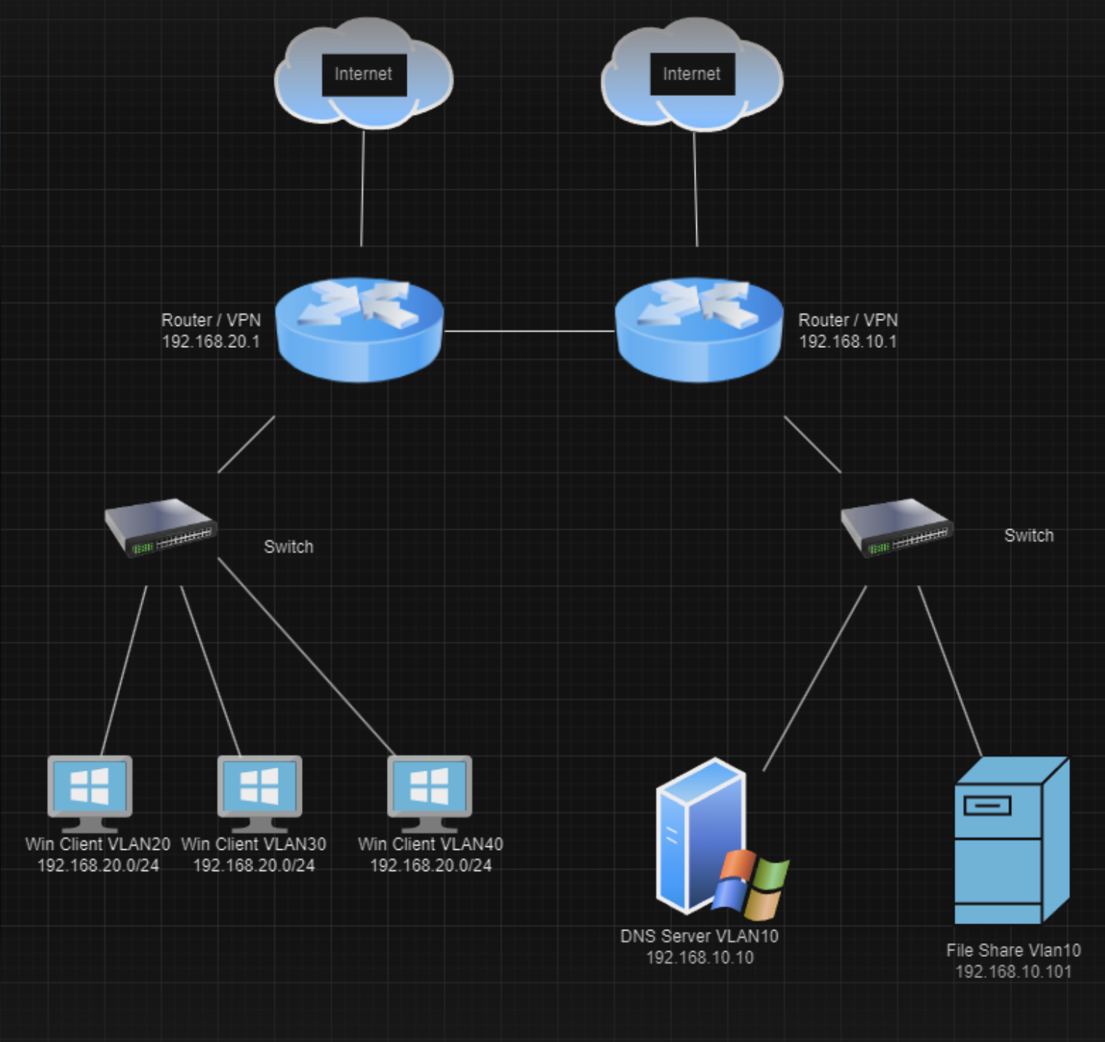
TOPOLOGY

Slide 12
DEMO!

Slide 13

Thank You: Our NPV Team Marco Vazquez Roger Huba Zachary Derrick Ben Arno

Slide 14

QUESTIONS?

